Slide 1
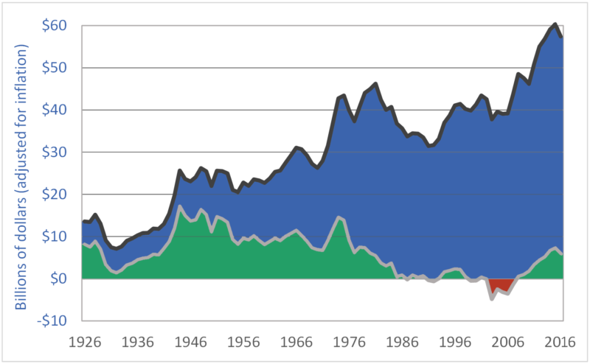
Canadian Gross Farm Income and Net Revenue, 1926-2016
This graph shows data from Canada. The story of Canada and the US is pretty similar, but I was not able to find this exact graph for the US. Note that net revenue, an approximation of profits, falls over time. The blue part of the graph is the share of revenues that the farmer does not keep. The green part is profits.
Gross Income
Net Revenue
Source: Darrinqualmin.com, Statistics Canada

Slide 2
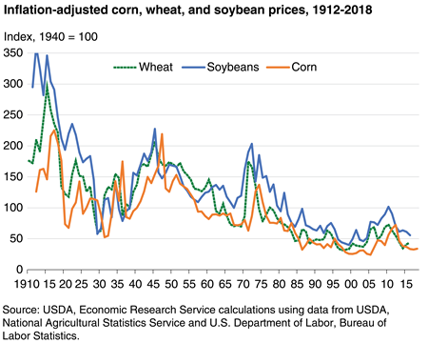
Crop prices fall as per acre yields rise
Farmers produced more per acre while using more and more purchased agrochemicals, and reduced labor costs through mechanization. Thus farm and animal labor from within the farm was replaced with inputs and machinery from off the farm. Crop rotation, manuring, and crop diversity was replaced by fertilizer use.
One result was falling profits. Much of field crop farmer income has come from government subsidies. I remember as a farmer myself the first ten years of my adult life a saying in the community: “Behind every successful farmer is a wife that works in town.”
Another result from the heavy pesticide and fertilizer use, together with heavy tillage, is declining soil carbon - the subject of much of the Montgomery and Bickle book.

